Slide 1
PUNYASHLOK AHILYADEVI HOLKAR
SOLAPUR UNIVERSITY
SOLAPUR
DEPARTMENT OF STATISTICS
SEMINAR ON
“GREEDY algorithm & Its Application”
PRESNTED BY
Sneha tavati
m.sc-II (sem-vi)

Slide 2
CONTENTS
Introduction
Steps For Achieving Greedy Algorithm
Applications
Activity Selection Problem
Fractional Knapsack Problem
Travelling Sales Person Problem

Slide 3
introduction
Greedy is an algorithmic paradigm that builds up a solution piece by piece, always choosing the next piece that offers the most obvious and immediate benefit. So the problems where choosing locally optimal also leads to global solution are best fit for greedy. i.e In this method we have to find out the best option out of many present ways. It is one of the optimization technique. Many optimization problems can be solved using this algorithm. Some issues have no efficient solution, but a greedy algorithm may provide a solution that is close to optimal.

Slide 4
A greedy algorithm works if a problem exhibits the following two properties.
Greedy Choice Property:
A globally optimal solution can be reached at by creating a locally optimal solution. In other words, an optimal solution can be obtained by creating “greedy” choices.
Optimal Substructure:
Optimal solutions contain optimal sub-solutions. In other words, answers to sub-problems of an optimal solution are optimal.

Slide 5
STEPS FOR ACHIEVING GREEDY ALGORITHM
Feasible: here we check whether it satisfies all possible constraints or not, to obtain at least one solution to our problems.
Local optimum choice: in this, the choice should be the optimum which is selected from the currently available options.
Unalterable: once the decision is made, at any subsequence step that option is not altered.

Slide 6
APPLICATIONS
Activity Selection Problem
Fractional Knapsack Problem
Travelling Sales Person Problem
Job Sequencing

Slide 7
Activity Selection Problem
EXAMPLE: GIVEN 10 ACTIVITIES ALONG WITH THEIR START AND END TIME AS
COMPUTE A SCHEDULE WHERE THE GREATEST NUMBER OF ACTIVITIES TAKE PLACE.
SOLUTION: ARRANGE THE ACTIVITIES IN INCREASING ORDER OF FINISH TIME AS FOLLOWS:
NOW, SCHEDULE A₁ . SKIP A₂ AS IT IS INTERFERING.
NEXT SCHEDULE A₃ AS A₁ AND A₃ ARE NON-INTERFERING.
NEXT SCHEDULE A₄ AS A₁ , A₃ AND A₄ ARE NON-INTERFERING.
Activity | A₁ | A₂ | A₃ | A₄ | A₅ | A₆ | A₇ | A₈ | A₉ | A₁₀
Start | 1 | 2 | 3 | 4 | 7 | 8 | 9 | 9 | 11 | 12
Finish | 3 | 5 | 4 | 7 | 10 | 9 | 11 | 13 | 12 | 14
Activity | A₁ | A₃ | A₂ | A₄ | A₆ | A₅ | A₇ | A₉ | A₈ | A₁₀
Start | 1 | 3 | 2 | 4 | 8 | 7 | 9 | 11 | 9 | 12
Finish | 3 | 4 | 5 | 7 | 9 | 10 | 11 | 12 | 13 | 14

Slide 8
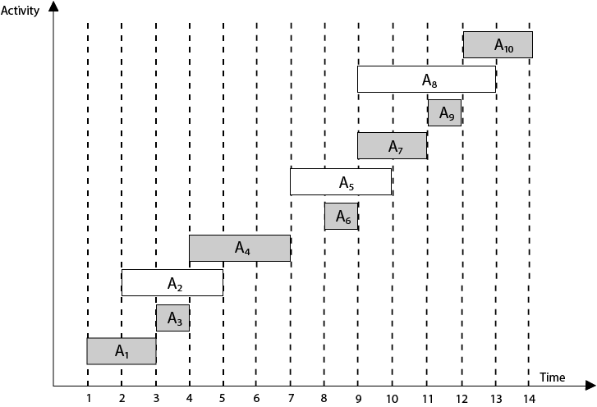
Continuing in this way the final Activity Schedule is :
( A₁ A₃ A₄ A₆ A₇ A₉ A₁₀ )
Graphically we can show this as

Slide 9

Fractional Knapsack Problem
Example: Consider 5 items along with their respective weights and values:
Solution: Let the capacity of knapsack W = 60
Compute the ratio $Pi=\frac{Vi}{Wi} for each item$
Items | I₁ | I₂ | I₃ | I₄ | I₅
Weight | 5 | 10 | 20 | 30 | 40
Value (profit) | 30 | 20 | 100 | 90 | 160
Item | Weight | Value | Pi
I₁ | 5 | 30 | 6
I₂ | 10 | 20 | 2
I₃ | 20 | 100 | 5
I₄ | 30 | 90 | 3
I₅ | 40 | 160 | 4

Slide 10
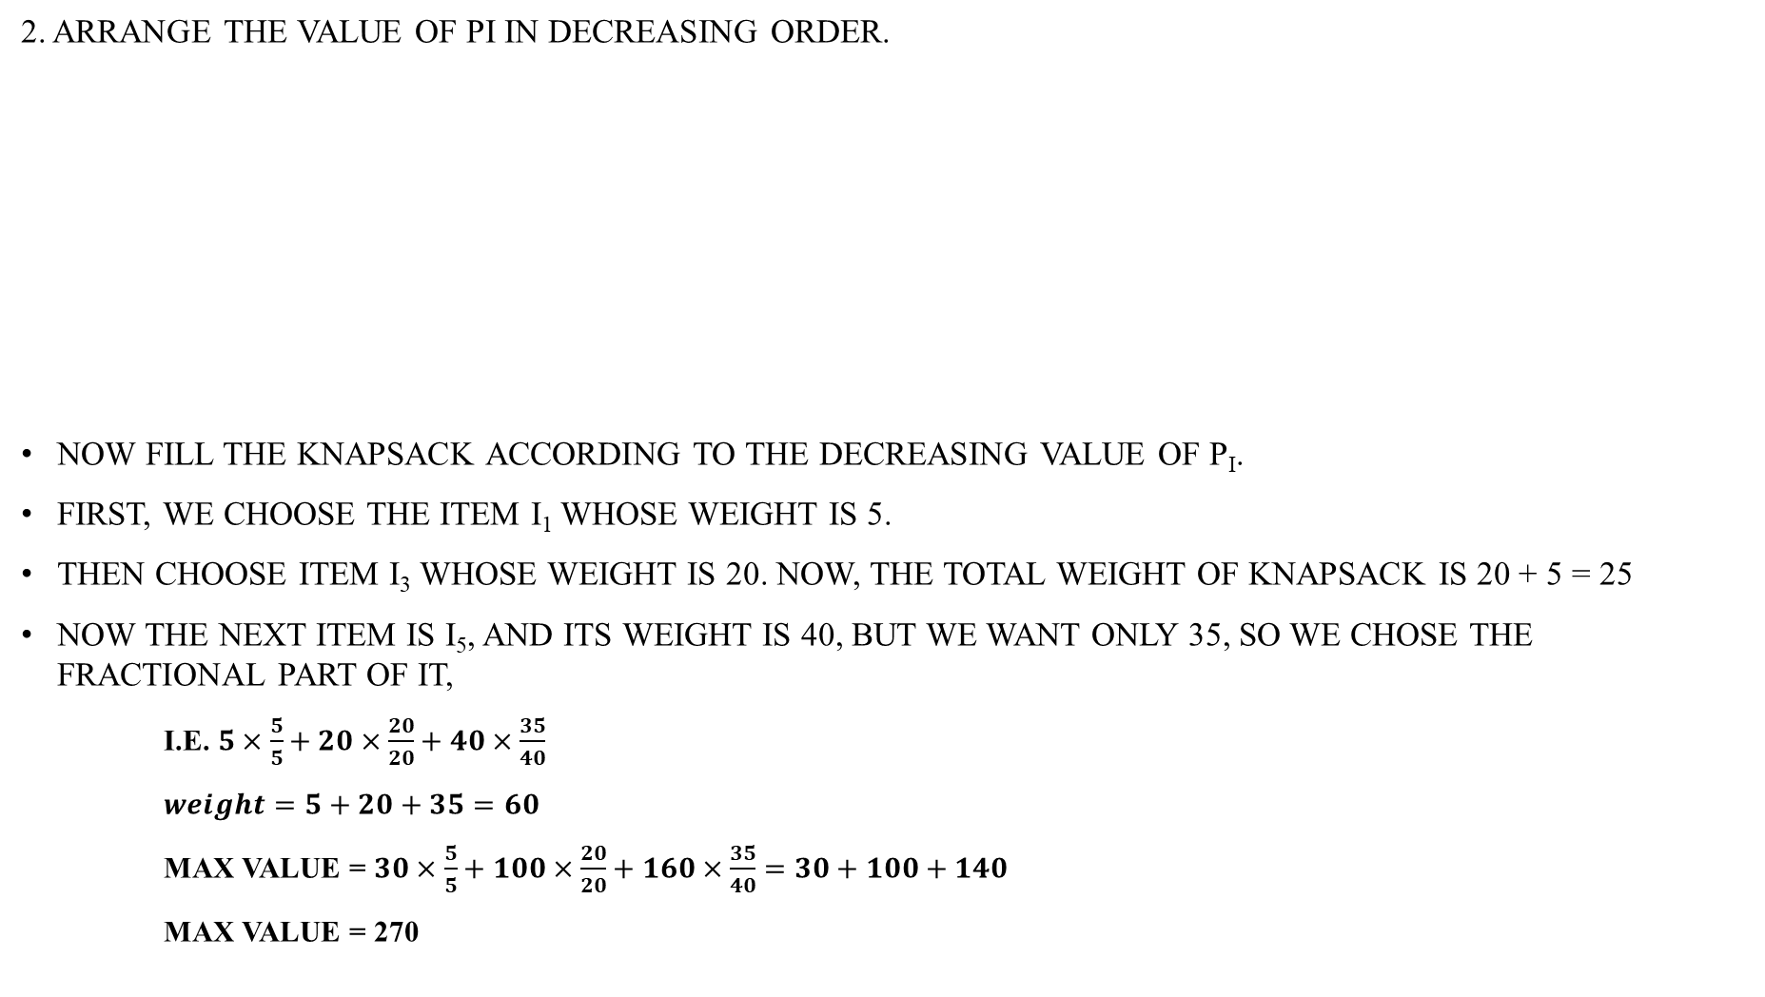
2. Arrange the value of Pi in decreasing order.
Now fill the knapsack according to the decreasing value of P_{i}.
First, we choose the item I₁ whose weight is 5.
Then choose item I₃ whose weight is 20. Now, the total weight of knapsack is 20 + 5 = 25
Now the next item is I₅, and its weight is 40, but we want only 35, so we chose the fractional part of it,
i.e. $5×\frac{5}{5}+20×\frac{20}{20}+40×\frac{35}{40}$
$weight=5+20+35=60$
Max Value = $30×\frac{5}{5}+100×\frac{20}{20}+160×\frac{35}{40}=30+100+140$
Max Value = 270
Item | Weight | Value | Pi
I₁ | 5 | 30 | 6
I₃ | 20 | 100 | 5
I₅ | 40 | 160 | 4
I₄ | 30 | 90 | 3
I₂ | 10 | 20 | 2

Slide 11
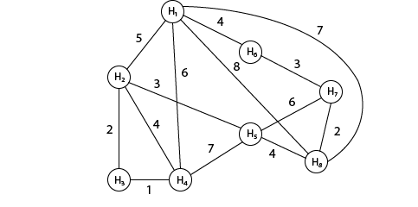
Travelling Sales Person Problem
Example: A newspaper agent daily drops the newspaper to the area assigned in such a manner that he has to cover all the houses in the respective area with minimum travel cost. Compute the minimum travel cost.
The area assigned to the agent where he has to drop the newspaper is shown in fig:

Slide 12
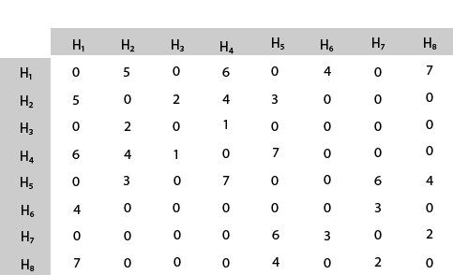
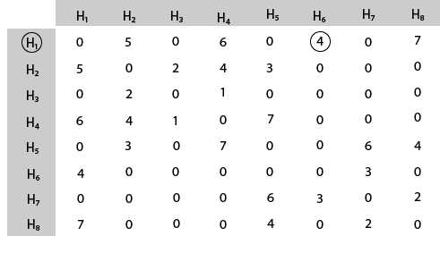
Solution: The cost adjacency matrix is as follows
C =
The tour starts from area H₁ and then select the minimum cost area reachable from H₁.

Slide 13
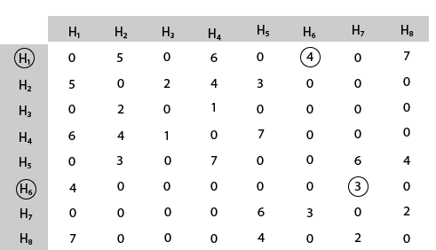
Mark area H₆ because it is the minimum cost area reachable from H₁ and then select minimum cost area reachable from H₆.
Continuing in this way we will get the optimal solution to our problem.
i.e. here the minimum cost for travelling .

Slide 14
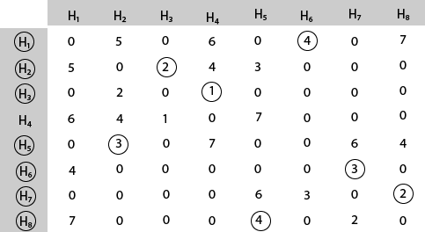
Finally using greedy method we get the following solution.
H₁ H₆ H₇ H₈ H₅ H₂ H₃ H₄ H₁
Thus the minimum travel cost = 4 + 3 + 2 + 4 + 3 + 2 + 1 + 6 = 25

Slide 15


Slide 16
REFERENCES
WWW.WIKIPEDIA.COM
WWW.TUTORIALSPOINT.COM
YOUTUBE VIDEOS

Slide 17
THANK YOU…

